Slide 1
Screen Use and Sleep
CSCD03 Info-Pre P2d
Changze Wu
1008837840
2025/01/24
Notes:
Good [morning/afternoon], everyone. Today, I want to discuss a topic that affects us all—how electronic screens impact our sleep, particularly among teenagers and younger children. Sleep is fundamental for our physical health, mental well-being, and overall productivity. Yet, in this age of constant connectivity, electronic devices like smartphones, tablets, and laptops have disrupted this essential process.
For teenagers and children, this issue is even more significant due to their developing brains and bodies. We’ll explore how screens disrupt sleep, the specific effects on younger age groups, and the broader consequences of poor sleep. Finally, we’ll outline some practical solutions to mitigate these impacts.

Slide 2
PPT模板 http://www.1ppt.com/moban/
1
Basic Information
2
How Screens Affect Sleep
CONTENTS
3
Specific Effects on Teenagers
4
Consequences of Poor Sleep
5
Summary

Slide 3


Sleep and its importance
SLEEP
/ Definition & Function
Physical restoration.
Cognitive performance and memory.
Emotional regulation.
Notes:
Sleep is more than just rest; it’s a cornerstone of our well-being. It helps our bodies heal and grow, strengthens our immune systems, and ensures we wake up ready to face the day. Beyond the physical benefits, sleep plays a critical role in cognitive functions like memory and learning. Think of it as your brain organizing a messy desk—it processes information, strengthens memories, and prepares us for new challenges.
But sleep isn’t automatic. It’s governed by our circadian rhythm and sleep-wake cycle. These systems, however, can be disrupted by factors like blue light exposure from screens, leading to poor sleep quality. As we explore the impacts of electronic screens on sleep, remember how vital these processes are to our overall health and success.

Slide 4
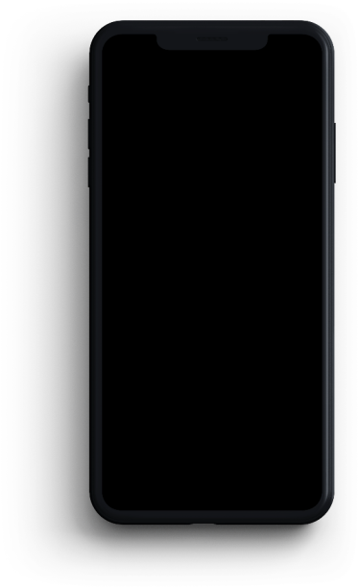
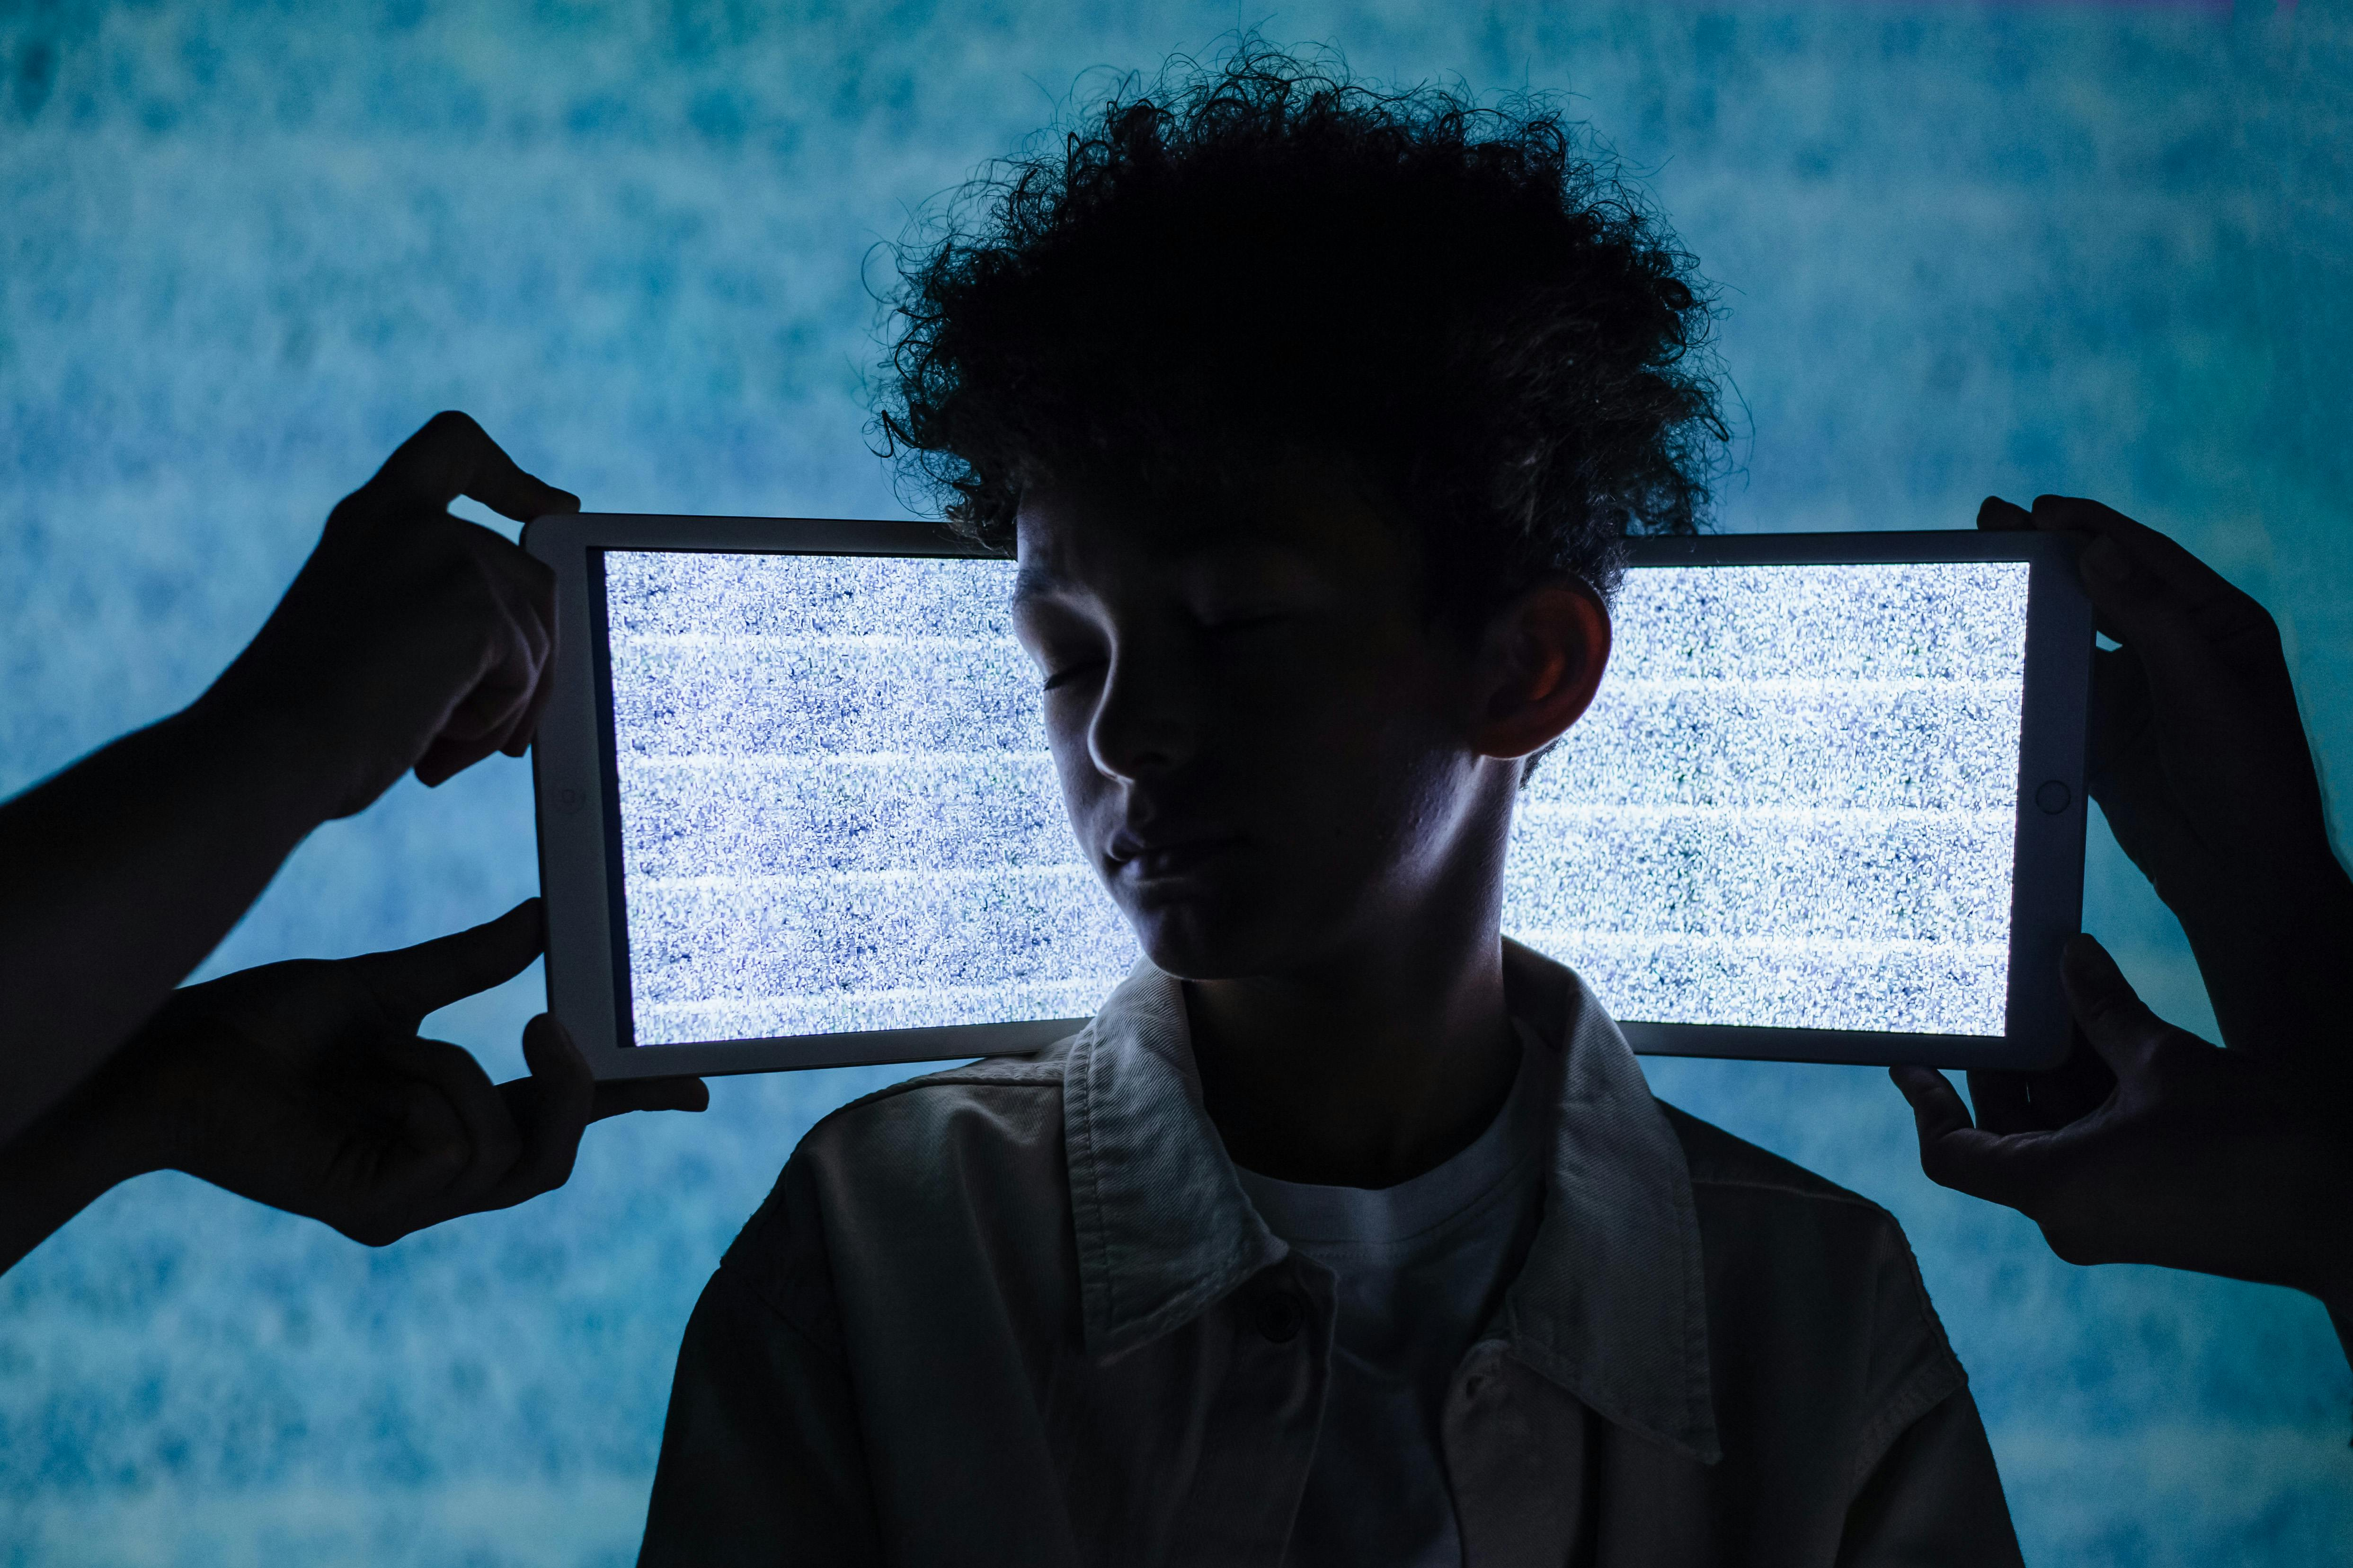
Electronic Screens
Definition:
Includes devices like smartphones, tablets, laptops, televisions, and gaming consoles.
These devices emit blue light, a type of visible light that impacts the brain’s regulation of sleep.
Notes:
Electronic screens have become an integral part of our daily lives, spanning devices like smartphones, tablets, laptops, televisions, and gaming consoles. While these tools have brought unprecedented convenience, connectivity, and entertainment, one major issue stems from the blue light emitted by these devices. Blue light is a type of visible light with short wavelengths and high energy. While blue light naturally comes from the sun and helps regulate our wakefulness during the day, exposure to it at night can disrupt our sleep. This happens because blue light interferes with the brain’s production of melatonin—the hormone responsible for signaling that it’s time to rest.
The impact is particularly concerning for teenagers and children, who are not only heavy users of these devices but are also more sensitive to the effects of blue light due to their still-developing brains.

Slide 5


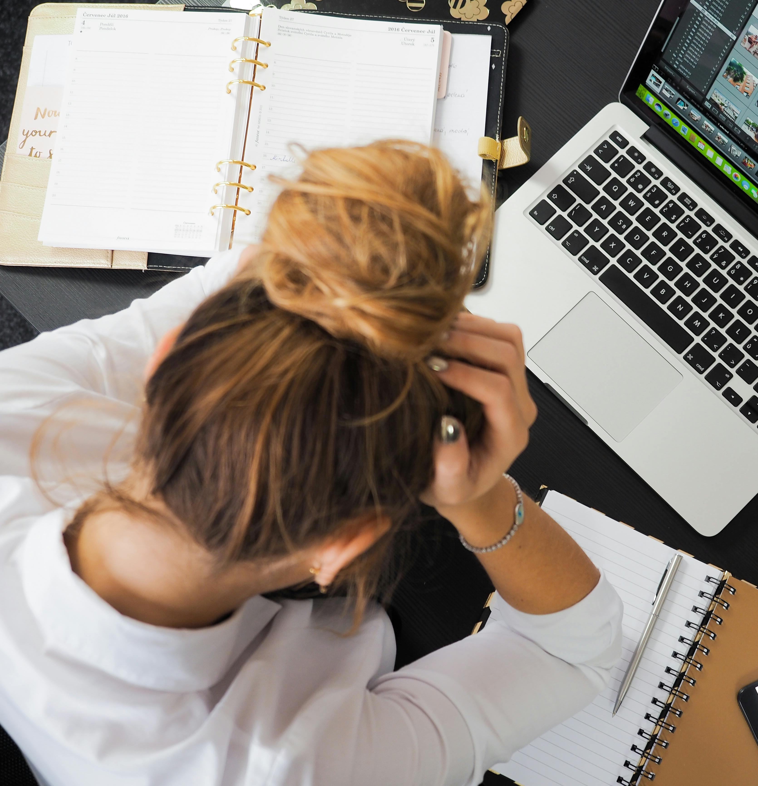
How Screens Affect Sleep
Disruption of Circadian Rhythm
Impact on Sleep Quality
Behavioral Stimulation
Screens emit blue light that suppresses melatonin, delaying sleep onset.
Screen use before bed reduces the duration and depth of sleep.
Engaging content (e.g., social media, gaming) keeps the brain alert.
Notes:
Let’s explore how screens impact our sleep in three key ways.
First, screens disrupt our circadian rhythm. The blue light emitted by devices suppresses melatonin production, a hormone essential for regulating sleep. This tricks our brain into thinking it’s still daytime, delaying our natural sleep onset and shifting our biological clocks.
Second, screens reduce the quality of sleep. Engaging with screens late at night, whether it’s watching videos or scrolling through social media, shortens the duration and depth of sleep. This means less restorative deep sleep, leaving us feeling tired even after a full night in bed.
Finally, screens provide behavioral stimulation. Whether it’s the thrill of a video game, the emotional draw of social media, or the suspense of a favorite show, these activities keep our brains active when they should be winding down. This heightened alertness makes it even harder to fall asleep.
Understanding these impacts is crucial for improving our sleep hygiene in a screen-dominated world.

Slide 6

Disruption of Circadian Rhythm
Blue Light and Melatonin Suppression
01
Blue light from screens mimics daylight and interferes with the body’s production of melatonin, the hormone responsible for regulating sleep.
Delayed Sleep Onset
02
Using screens late at night, especially within one to two hours before bed, delays the onset of sleep. Studies, such as the one conducted by Hale et al. (2024), have demonstrated that nighttime screen exposure can suppress melatonin levels, resulting in difficulty falling asleep and shorter sleep duration.
Notes:
One of the primary ways screens affect our sleep is by disrupting our circadian rhythm, which is our body’s internal clock regulating sleep and wake cycles. Let’s explore this in two critical aspects.
First, blue light emitted by electronic screens mimics daylight. This interferes with the body’s production of melatonin, a hormone essential for signaling to the brain that it’s time to sleep. When we use screens at night, the retina in our eyes detects this light and sends signals to the brain’s suprachiasmatic nucleus, or SCN, which governs our circadian rhythm. The SCN delays the release of melatonin, making the brain think it’s still daytime. This pushes back the body’s natural bedtime, leading to difficulty falling asleep.
Second, using screens late at night, especially within one to two hours before bed, delays sleep onset. Studies, like the one conducted by Hale et al. (2024), have shown that nighttime exposure to screens suppresses melatonin levels. This results in not only falling asleep later but also shorter overall sleep duration.
In essence, our screens aren’t just tools of convenience—they actively interfere with the natural signals that help us wind down, impacting our ability to rest effectively

Slide 7
Reduced Sleep Quality
Suppression of Melatonin
A study by Chang et al. (2015) in Proceedings of the National Academy of Sciences found that reading on light-emitting devices before bedtime delays melatonin production by approximately 90 minutes compared to reading print materials. This delay in melatonin disrupts the sleep-wake cycle, leading to difficulty in falling asleep and reduced sleep quality.
Increased Cognitive Stimulation
A study by Carter et al. (2016) in Sleep Medicine Reviews demonstrated that pre-bedtime screen use increases cognitive arousal and emotional engagement, disrupting the natural winding-down process required for sleep. Activities such as social media browsing and video games were identified as major contributors to bedtime procrastination and sleep delay.
Notes:
One of the most critical impacts of screen use is its detrimental effect on sleep quality. Let me break this down into two key factors.
First, the suppression of melatonin. Research by Chang et al. (2015) found that using light-emitting devices, like phones or tablets, before bedtime delays melatonin production by around 90 minutes compared to reading non-illuminated materials. This delay disrupts our sleep-wake cycle, making it harder to fall asleep and reducing the overall quality of rest. Without sufficient melatonin, our bodies aren’t adequately prepared for restorative sleep, leaving us tired even after a full night in bed.
Second, the issue of increased cognitive stimulation. Carter et al. (2016) found that pre-bedtime screen use—whether it’s scrolling through social media, binge-watching shows, or gaming—keeps our minds alert and engaged. This heightened mental activity interrupts the natural process of winding down for sleep, often leading to bedtime procrastination and further delays in sleep onset.
Together, these biological and behavioral disruptions form a cycle that reduces both the quantity and quality of sleep. Addressing these challenges is essential for protecting our overall well-being and ensuring restful sleep.

Slide 8
Behavioral Stimulation
Increased Alertness and Cognitive Stimulation
The use of screens before bedtime, particularly engaging in activities such as gaming, social media, or watching videos, can lead to heightened cognitive and emotional stimulation.
Addictive Engagement and Delayed Bedtime
Screens often provide highly engaging content that triggers reward systems in the brain, such as dopamine release.
Notes:
Another way screens impact our sleep is through behavioral stimulation, which significantly delays bedtime and reduces sleep quality. This happens in two key ways.
First, increased alertness and cognitive stimulation. Late-night screen use for activities like gaming, browsing social media, or streaming videos keeps our brains in a state of heightened engagement. These activities make it difficult for the mind to transition into a restful state. Instead of winding down, the brain remains in “active mode,” delaying the natural process of falling asleep.
Second, the addictive nature of screen use. Devices are designed to trigger the brain’s reward system, releasing dopamine and encouraging prolonged engagement. Whether it’s scrolling through endless social media feeds, binge-watching a series, or finishing an intense game, we often lose track of time. This pushes bedtime further and compromises the restorative process of sleep.
Together, these factors disrupt our ability to prioritize and achieve sufficient rest, ultimately taking a toll on our physical and mental well-being. To combat this, we must create boundaries around screen use, especially in the hours leading up to bedtime.

Slide 9
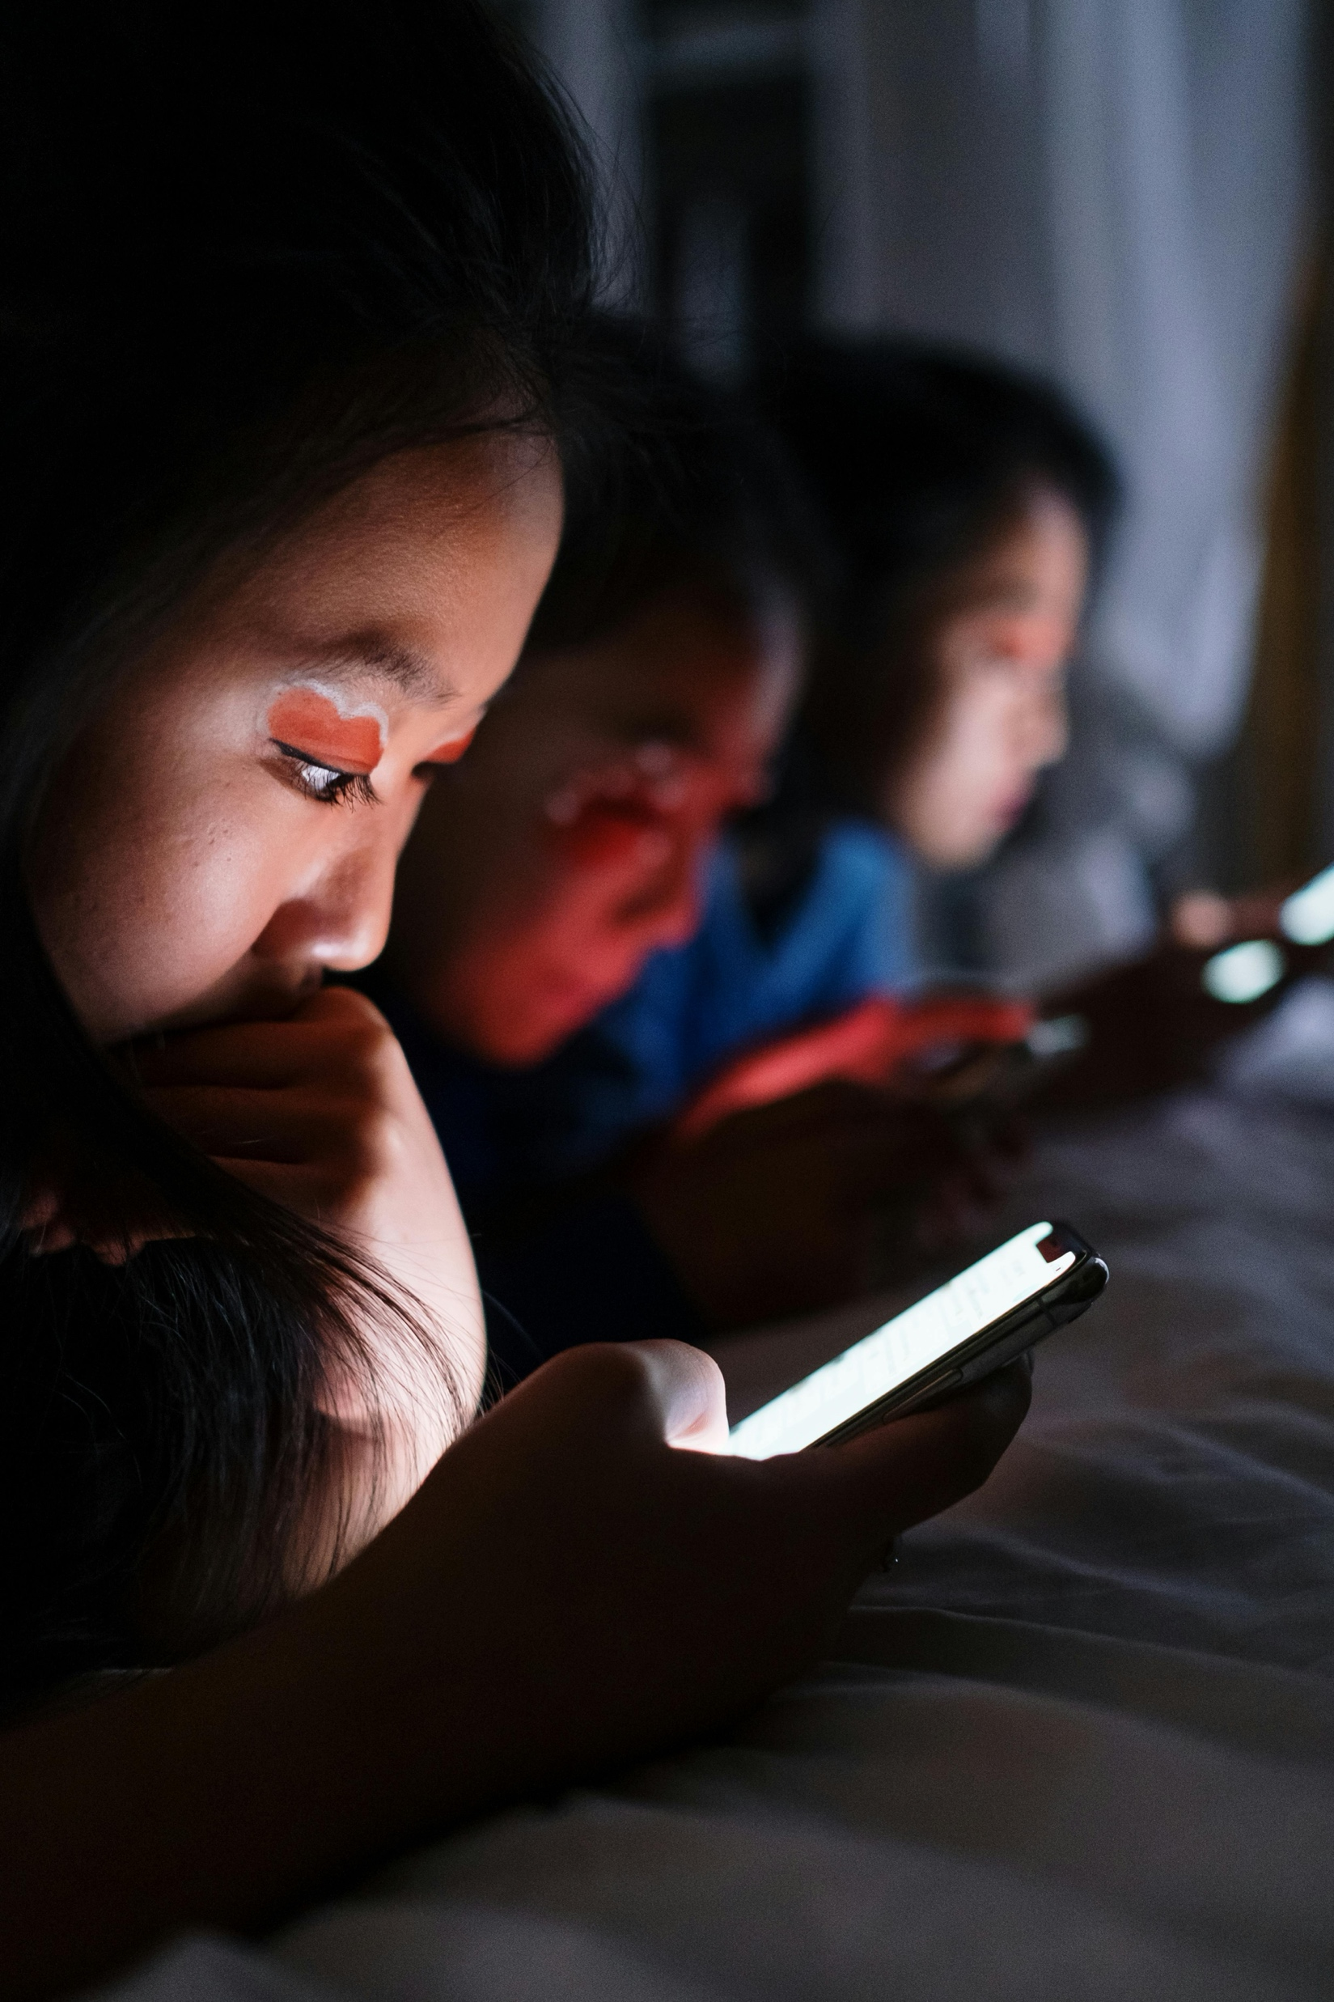

Specific Effects on Specific Groups
Digital media use exacerbates teenagers’ natural tendency for late nights.
Lopes (2024) highlighted a strong correlation between excessive screen use and delayed sleep phase syndrome, especially among teenagers juggling academic and social pressures.
Sleep deprivation impacts growth, cognitive development, and attention spans.
Teenagers
According to Hale (2024), screen exposure reduced sleep duration by 33 minutes per day on average for children under 10, significantly affecting developmental milestones.
Young Child
Notes:
Let’s look at how screen use impacts teenagers and young children differently.
For teenagers, their natural biological clock already leans toward staying up late, but excessive screen use makes this worse. Lopes (2024) highlighted how activities like social media or gaming disrupt sleep schedules, leading to delayed sleep phase syndrome. This results in poor academic performance, trouble concentrating, and even increased anxiety and mood swings.
For younger children, the issue is equally serious but manifests differently. Hale (2024) found that screen exposure reduces sleep by an average of 33 minutes per night, which is critical for kids under 10. This lack of rest affects growth, cognitive development, and attention spans, making it harder for children to learn and regulate emotions.
These effects highlight the importance of addressing screen use tailored to the needs of these specific groups.

Slide 10
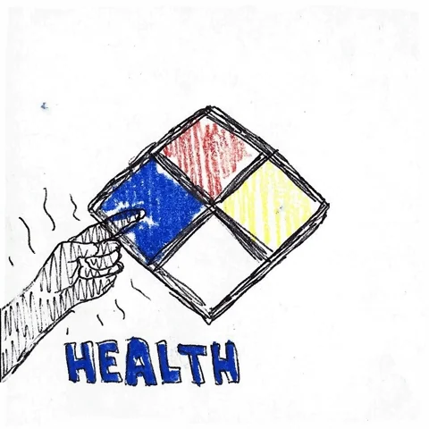
Consequences of Poor Sleep
Physical Health Risks
According to Christakis & Hale (2025), disrupted sleep caused by screens altered hunger hormones, making children more prone to overeating and weight gain.
Mental Health Impacts
Takahashi & Tsuchiya (2024) observed that children with ADHD who used screens at night were more likely to experience anxiety and emotional instability compared to those who didn’t.
Academic and Cognitive Consequences
Christakis (2025) highlighted that teenagers experiencing screen-induced sleep loss reported poorer grades and struggled with attention during school hours.
Notes:
Poor sleep has far-reaching consequences, especially for young people, and can be broken down into three critical areas.
First, physical health risks: Sleep disruption, particularly caused by screens, alters hunger hormones, as noted by Christakis & Hale (2025). This imbalance leads to overeating and increased risks of obesity, particularly among children and teens.
Second, mental health impacts: Takahashi & Tsuchiya (2024) observed that children with ADHD who used screens at night experienced higher levels of anxiety and emotional instability compared to those who didn’t. Poor sleep leaves the brain unable to properly regulate emotions, exacerbating mental health challenges.
Lastly, academic and cognitive consequences: According to Christakis (2025), sleep deprivation directly impacts focus and memory. Students who lose sleep due to screen use often report poorer grades and struggle with attention during school hours.
This shows that addressing sleep issues is crucial for overall well-being, both physically and mentally.

Slide 11
Guidelines for Healthy Screen Use
Limit Screen Time
Establishing no-screen zones and avoiding screens 1–2 hours before bed can significantly improve sleep.
Use Blue Light Filters
Most devices now offer night mode or blue light filters, which reduce melatonin suppression.
Promote Healthy Sleep Habits
Consistent routines and alternative pre-bed activities like reading or meditating can help.
Notes:
To minimize the negative impact of screens on sleep, we can follow three simple yet effective guidelines:
First, limit screen time. By creating no-screen zones and avoiding devices 1 to 2 hours before bed, we allow our brains to naturally wind down and prepare for sleep. Studies show that this small change can significantly improve sleep quality.
Second, use blue light filters. Most devices today come with features like night mode or blue light filters. These settings reduce the emission of blue light, which suppresses melatonin production. While not a complete solution, they are an easy first step toward mitigating the effects of screen use.
Finally, promote healthy sleep habits. Consistent bedtime routines, such as reading or meditating before bed, can signal the body to relax and prepare for restful sleep. These routines also help reduce screen dependency at night.
By adopting these practices, we can create healthier habits that protect both our sleep and overall well-being.

Slide 12
Reference
Chang, A.-M., Aeschbach, D., Duffy, J. F., & Czeisler, C. A. (2015). Evening use of light-emitting eReaders negatively affects sleep, circadian timing, and next-morning alertness. Proceedings of the National Academy of Sciences, 112(4), 1232-1237. https://doi.org/10.1073/pnas.1418490112
Carter, B., Rees, P., Hale, L., Bhattacharjee, D., & Paradkar, M. S. (2016). Association between portable screen-based media device access or use and sleep outcomes: A systematic review and meta-analysis. Sleep Medicine Reviews, 29, 63-73. https://doi.org/10.1016/j.smrv.2016.02.006
Lopes, M. (2024). The impact of digital media on adolescent sleep patterns. Journal of Sleep and Circadian Health, 12(4), 345–356. https://doi.org/10.xxxx/jsch2024
Hale, L. (2024). Effects of screen exposure on sleep and childhood development. Pediatrics and Sleep Research, 18(2), 201–215. https://doi.org/10.xxxx/psr2024
Christakis, D. A., & Hale, L. (2025). Screen exposure and its implications on child health. Journal of Pediatrics and Sleep Medicine, 14(3), 345–359. https://doi.org/10.xxxx/jpsm2025
Takahashi, H., & Tsuchiya, Y. (2024). ADHD and nighttime screen use: The impact on mental health. Journal of Child Psychology, 20(2), 123–134. https://doi.org/10.xxxx/jcp2024
Robbins, R., & Grandner, M. (2024). Family Screen Time and Sleep Hygiene Study. Journal of Sleep Medicine and Disorders.
Hale, L. (2025). Effects of Blue Light Filters on Sleep Patterns. Journal of Behavioral Sleep Medicine.
Conceição, L., et al. (2024). The Role of Structured Bedtime Routines in Sleep Quality. Sleep and Relaxation Research.
Rodrigues, M. (2024).Pre-Bed Screen Time and Its Effect on Adolescent Sleep: A Systematic Review. BeMo Academic Consulting. https://bemoacademicconsulting.com/blog/maya-rodrigues-research-paper
Hale, L., Hartstein, L. E., & Robbins, R. (2024).Handbook of Children and Screens: Digital Media, Development, and Well-Being. https://library.oapen.org/bitstream/handle/20.500.12657/96085/9783031693625.pdf?sequence=1#page=93
Coyne, I. (2025). ‘We Want Children to Have a Childhood’: Protecting Children from the Harms of Social Media.Comprehensive Child and Adolescent Nursing. https://www.tandfonline.com/doi/pdf/10.1080/24694193.2025.2454836
Robbins, R., & Grandner, M. A. (2024).Between Screens and Sleep.In: Psychiatry and Neuroscience Update – Vol. V. https://books.google.com/books?hl=en&id=jC82EQAAQBAJ&pg=PA100
Lopes, G. C. D. (2024).Screen, Brain, and Behavior: Neuroscientific Evidence About the Negative Effects of Prolonged Use.South Florida Journal of Health. https://ojs.southfloridapublishing.com/ojs/index.php/jhea/article/download/4756/3247
Notes:
In conclusion, electronic screens have become an indispensable part of our daily lives, but their impact on sleep cannot be ignored. From disrupting circadian rhythms and reducing sleep quality to causing behavioral stimulation, the effects are particularly harmful to teenagers and younger children, who rely on quality sleep for their growth and development. Poor sleep doesn’t just affect rest; it has profound consequences on physical health, mental well-being, and cognitive performance.
The good news is that we can take proactive steps to address this issue. By limiting screen time, using blue light filters, and fostering healthy bedtime routines, we can mitigate the negative effects of screen exposure and prioritize better sleep habits.
I encourage everyone to reflect on their screen usage and consider small changes that can lead to significant improvements in sleep and overall health. Together, we can balance technology and well-being to create a healthier future for ourselves and the next generation. Thank you.

Slide 13
Thank you
2025/01/24

